Slide 1
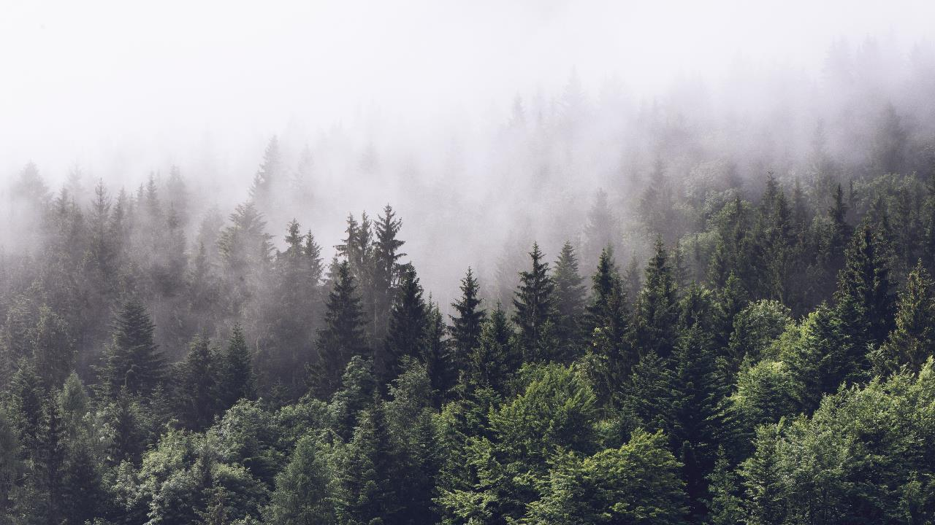
The Price of Privacy: Doxing and De-anonymization in the Digital Age
BSides
23.03.2024
Nikol Georgieva & Kaloyan Ivanov

Slide 2
Who are we?
Nikol Georgieva
Kaloyan Ivanov
Senior Threat Intelligence Researcher at GroupSense
Started working in Threat Intelligence in 2021
Passionate about Deep Web research, crafting personas and immersing myself undercover
Threat Intelligence Research Manager at GroupSense
Started working in Threat Intelligence in 2020
Passion for communicating with threat actors

Slide 3


Content
What is doxing?
Why is it dangerous
Case study
Disclaimer
Social Media
Google Dorks
Deep and Dark web data
OSINT
Summary
How can we protect ourselves?

Slide 4
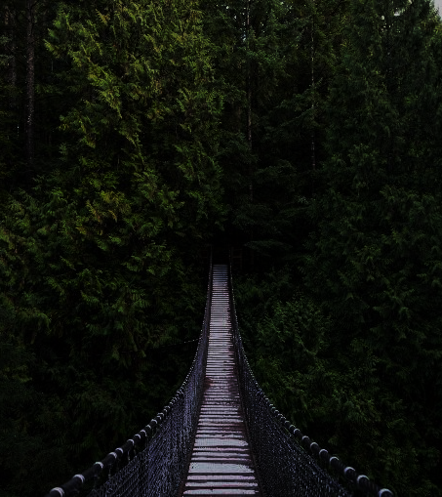

What is doxing?
malicious act of revealing personal and private information about a person without their consent
common method used by threat actors to intimidate, harass or threaten people
leaked information could include name, address, phone number, pictures, social media profiles etc.

Slide 5
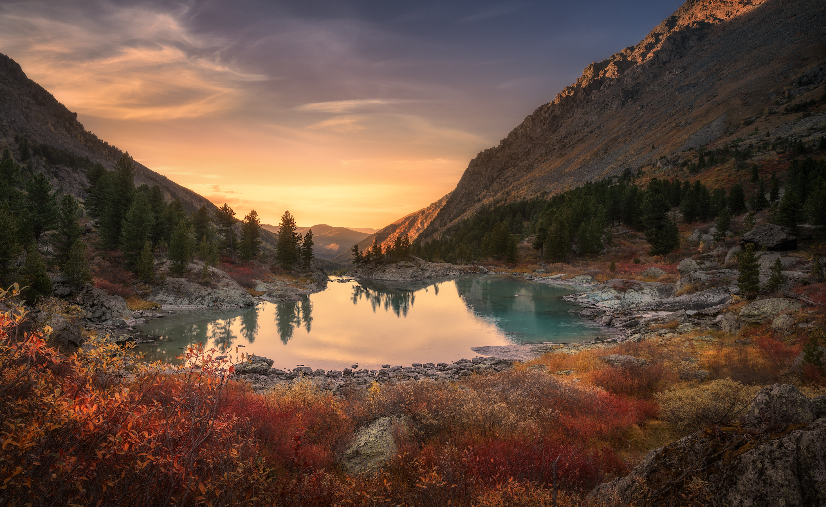
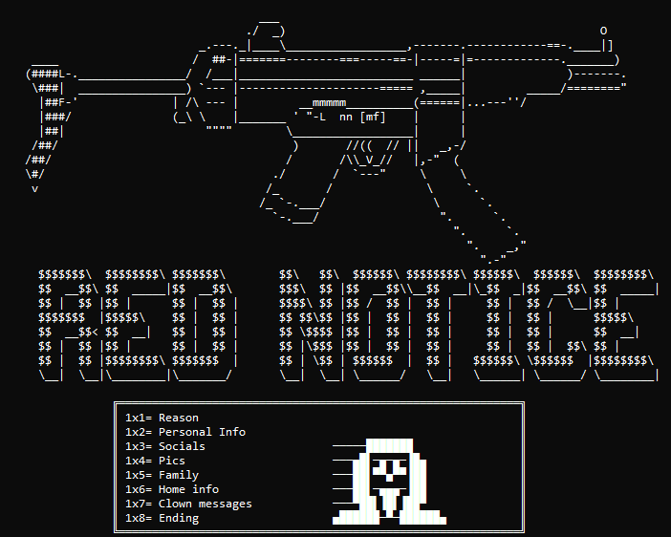
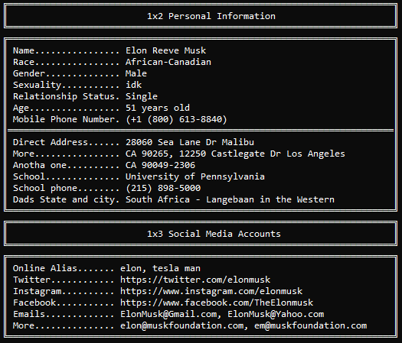

Slide 6

Why is doxing dangerous?
can be used as a method for revenge, punishment or threatening
can have serious consequences for the personal security and privacy
a starting point for a more sophisticated social engineering attack
information release during doxing can be used for identity theft

Slide 7

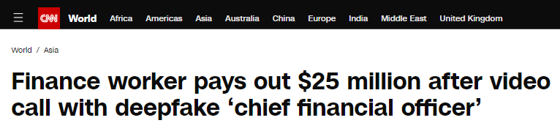
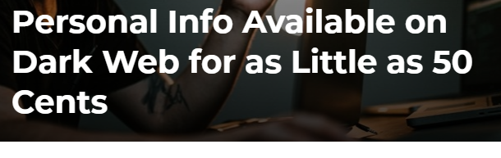


Slide 8


…so why should we “dox” ?
identify vulnerabilities in the personal digital posture
improve the security
identify potential attack vectors
threat actor investigations

Slide 9
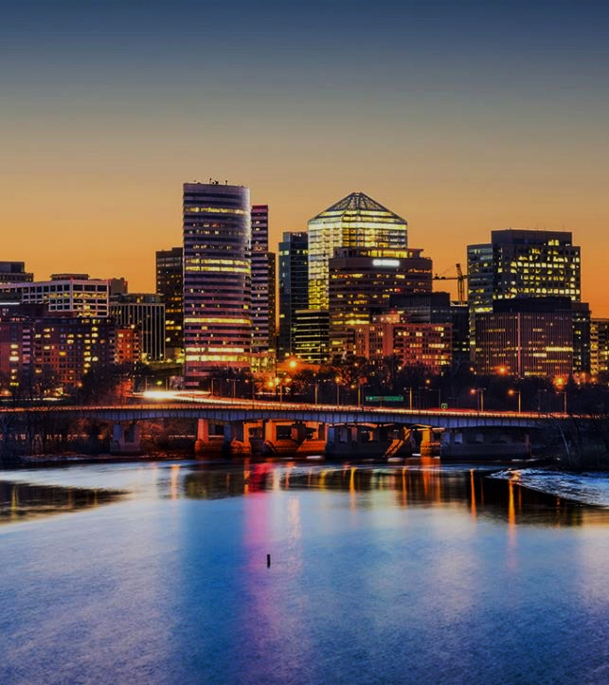
Case Study
Investigation of real person
Due to security concerns, the personal identifiable information is redacted

Slide 10
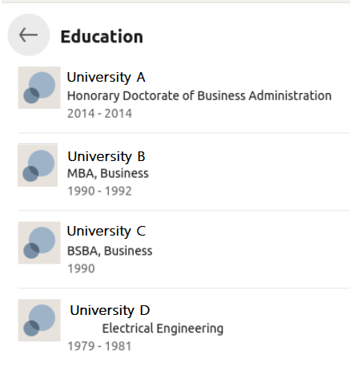
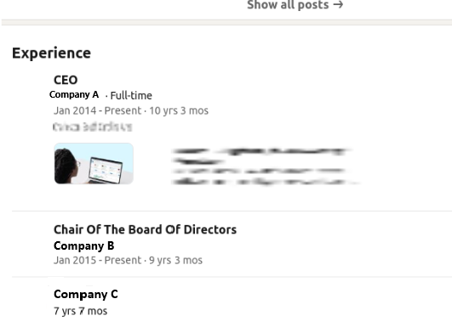
Social Media
LinkedIn: Your Professional Profile or a Doxing Playground?

Slide 11
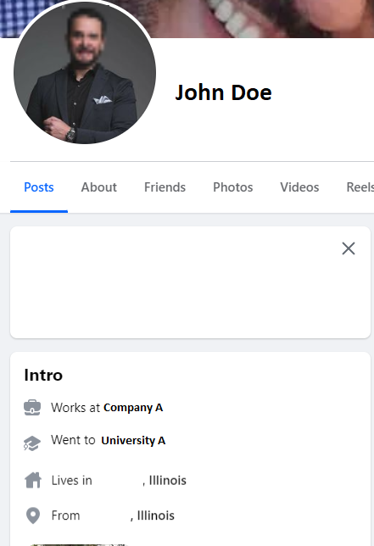
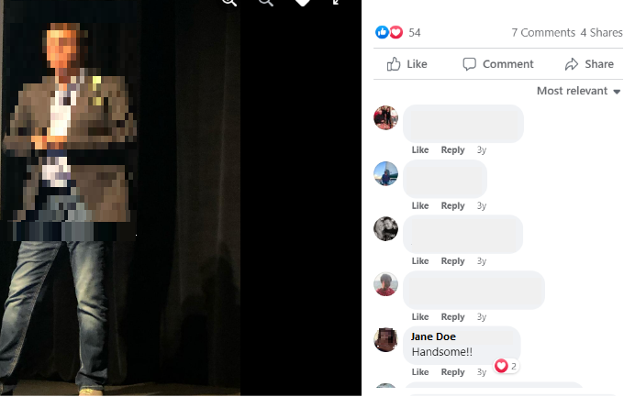
Social Media
Social Media

Slide 12
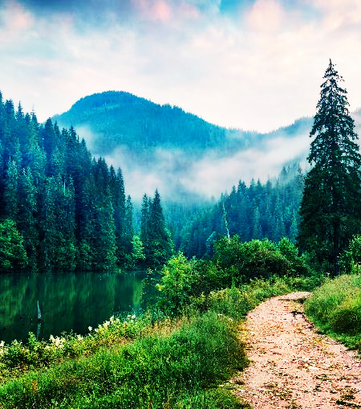
Google Dorks
Simple dorks with which you can check what’s available online for you
“Full name”
"Full Name" email OR phone OR "physical address"
site:facebook.com "username" | site:facebook.com “Full name”
site:twitter.com OR site:instagram.com OR site:facebook.com "full name" OR "username"
site:pastebin.com "username" OR "email" OR "password"
filetype:pdf OR filetype:doc "Name" resume OR CV
site:indeed.com OR site:linkedin.com "phone number" OR "email" OR "address" OR "resume"

Slide 13
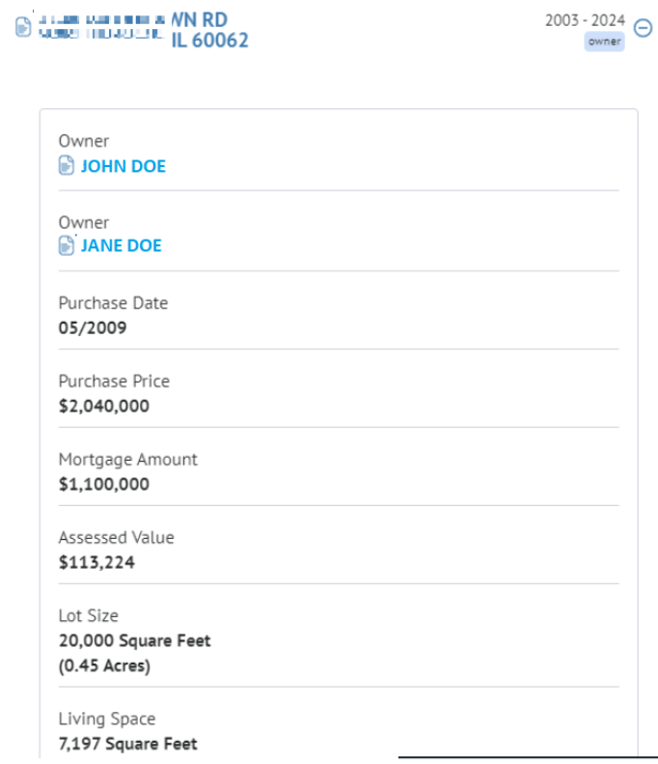
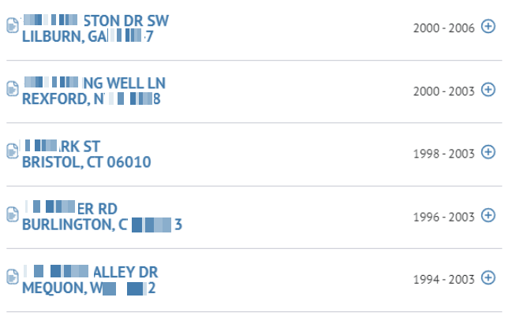

Slide 14
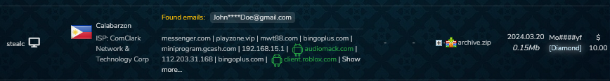
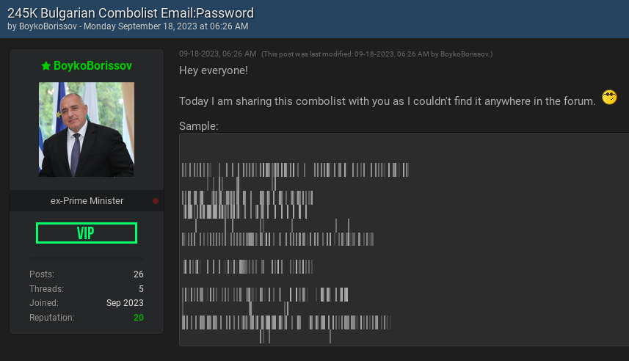
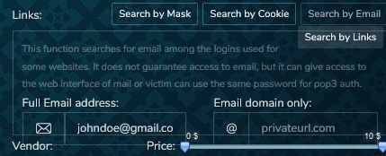
Deep and Dark web
TLP: Red

Slide 15
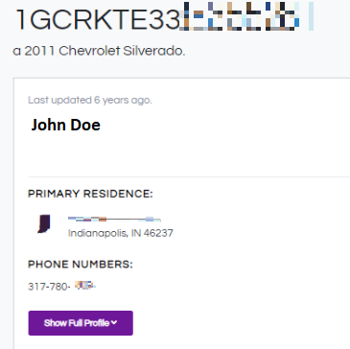
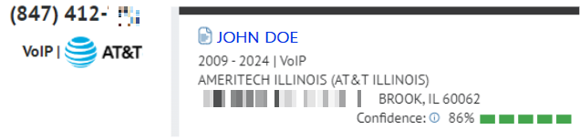
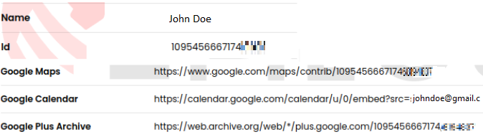
OSINT

Slide 16
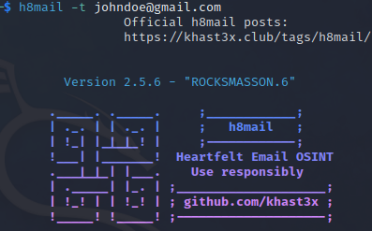
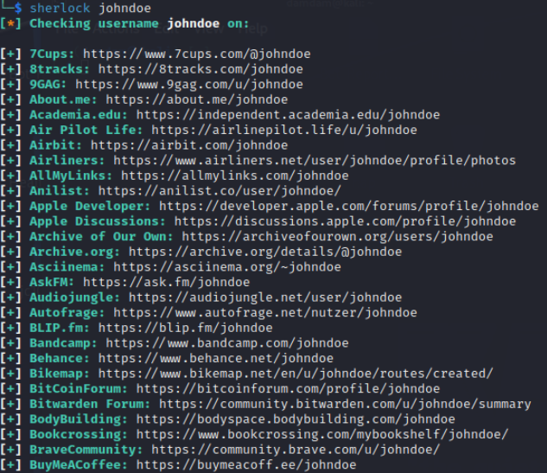
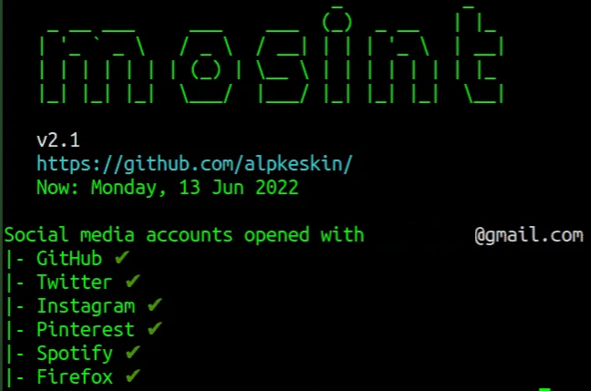
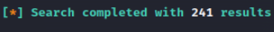


Slide 17
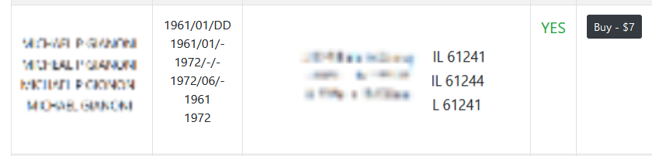

Slide 18
How can we protect ourselves?
don’t have all of your accounts linked tо one email address
set your posts to “friends only”
use strong passwords - at least 12 characters combing uppercase and lowercase letters, numbers, symbols. Change it every few months.
Use a VPN
Use unique usernames and passwords across platforms
Make all social media private and preferably remove any personal identifiable information (PII)

Slide 19
Thank you for your attention!
Nikol Georgieva
nikol.georgieva@groupsense.io
Kaloyan Ivanov
kaloyan.ivanov@groupsense.io

